Slide 1
Links below video
SAS Viya
SAS® Cloud Analytic Services: Fundamentals: https://go.documentation.sas.com/doc/en/pgmsascdc/v_024/casfun/titlepage.htm
SAS Viya Software: https://www.sas.com/en_us/software/viya.html
SAS and Python
SAS opens its code editor interface to Python users - https://blogs.sas.com/content/subconsciousmusings/2021/11/08/sas-studio-python-editor/
PYTHON Procedure: https://go.documentation.sas.com/doc/en/pgmsascdc/v_024/proc/p1iycdzbxw2787n178ysea5ghk6l.htm?homeOnFail
Using PROC PYTHON Callback Methods: https://go.documentation.sas.com/doc/en/pgmsascdc/v_023/proc/p1m1pc8yl1crtkn165q2d4njnip1.htm#n1x71i41z1ewqsn19j6k9jxoi5fa
(Webinar) But I Love Open Source – Why Do I Need SAS® Viya®? - https://www.sas.com/en_us/webinars/need-sas-viya.html
SWAT Package
Python SWAT GitHub- https://sassoftware.github.io/python-swat/getting-started.html
SWAT 1.9.3 documentation - SAS Software - https://sassoftware.github.io/python-swat/getting-started.html
Getting Started with the Python Interface of SAS Viya: https://video.sas.com/detail/video/5430217787001/getting-started-with-the-python-interface-of-sas-viya
SAS Tutorial | Python Integration with SAS Viya: https://www.youtube.com/watch?v=6cDU6JGEYSo
(Webinar) How Do I Use Python in SAS® Viya®?: https://www.sas.com/en_us/webinars/use-python-in-sas-viya.html
Blog Series
Getting Started with Python Integration to SAS® Viya® - Index: https://blogs.sas.com/content/sgf/2020/06/19/getting-started-with-python-integration-to-sas-viya-index/
CAS Action! - a series on fundamentals: https://blogs.sas.com/content/sgf/2021/08/06/cas-action-a-series-on-fundamentals/
SASPY Package
(Webinar)How Do I Use SASPy to Interface With SAS® From My Python Code?: https://www.sas.com/en_us/webinars/saspy-interface-from-python.html
SAS Tutorial | Using SAS in Python Applications With SASPy and Open Source Tools: https://www.youtube.com/watch?v=YL8xV0AOcMc
SAS Tutorial | How to Connect SAS and Python Using Jupyter Notebooks: https://www.youtube.com/watch?v=6mcsbeKwSqM

Slide 2
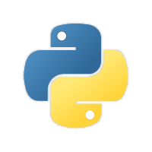

Python

Slide 3
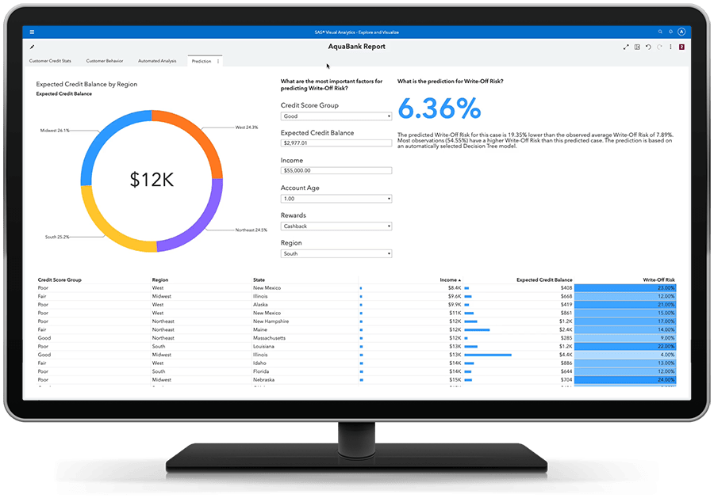
Do this in video, not slides. Maybe use icons in editing to pop up in video.
Business Problem
API
Retrieve data from a server using Python
Prepare data using Python or SAS
Create a dashboard using SAS Visual Analytics
Notes:
Let's get into our business problem. We want to create a scheduled job to populate a SAS Visual Analytics dashboard in our organization.
We need to perform the following steps:
Send an API call using the Python request package
Once we retrieve the data from the API call, we can process the data using Python packages or SAS programming, depending on your preferred tool. I'll show you both in the video.
Then lastly, create the SAS Visual Analytics dashboard.

Slide 4

Don't show slide. Show application menu in video when starting.
SAS Drive
Many More!
SAS Studio
SAS Environment Manager
SAS Visual Analytics
SAS Model Manager
SAS Data Studio
SAS Visual Forecasting
SAS Visual Data Mining and Machine Learning
SAS Visual Statistics
Notes:
SAS Viya is the latest enhancement of SAS platform. It's built for the entire analytics life cycle. It consists of many applications that enable you to work with your data no matter your job role or skill level.
Here, SAS Studio is the interactive development environment (IDE) in SAS Viya that enables you to program, execute Python code, build flows, and even use point-and-click tools to process your data.
SAS Visual Analytics enables you to visualize data, build statistical models, and create interactive dashboards with an easy-to-use point-and-click interface.

Slide 5
Steps:
Do demos first.
Then go over the architecture.

Slide 6


Instead of using this slide, just explain this in the Python how it works slide
Compute Server
CAS Server (CAS)
SAS Studio
Execute Traditional SAS
SAS/ACCESS
CAS Client
Notes:
Before we dive into using Python in SAS Studio, I need to give you a quick, high-level introduction into the SAS Viya architecture if you are not familiar with it. First, SAS Viya contains two servers for working with your data. This is important to understand.
The first is called the SAS Compute Server (which is similar to the SAS9 Workspace server for those of you familiar with SAS9),
The second is Cloud Analytics Services, or the CAS server for short. A massively parallel processing environment (or MPP) in SAS Viya.
To access SAS Viya, you log in using your browser and select an application. Here we will use SAS Studio. SAS Studio accesses SAS Viya through the compute server.
The compute server works like the traditional SAS9 workspace server. It is used to execute traditional SAS code that you've always used. Do you have programs that you want to execute as they have been for years? Use the SAS compute server.
The SAS compute server accesses data throughout your organization using the traditional SAS/ACCESS engine. Nothing new here.
And lastly, the SAS compute server acts as the client to access the CAS server.
executes traditional SAS®9 code
considered the SAS client

Slide 7
Instead of using this slide, just explain this in the Python how it works slide
Compute Server
CAS Server (CAS)
SAS Studio
Execute Traditional SAS
SAS/ACCESS
CAS Client
Parallel Processing Engine
In-Memory
SAS Viya Data Connectors
Notes:
So what is the CAS server?
Well, the CAS server is a high performance, massively parallel environment (or MPP), built to process big data and your resource intensive programs using modern analytics and all of your available SAS Viya applications like SAS Visual Analytics which we will see later. It's important to know that all SAS Viya applications process data in this distributed computing environment.
Next, the CAS server is an in-memory analytics engine. Data is loaded into memory in the CAS server for parallel processing and can persists in memory for multiple users until explicitly removed.
Lastly, the CAS server uses SAS Viya data connectors to access data across your organization.
Understanding this architecture is important when processing data in SAS Viya no matter the language or application being used.
I have some links below the video you can check out for detailed information about the CAS server.

Slide 8
Compute Server
CAS Server (CAS)
SAS Studio
SAS
Python
API
Notes:
I want to quickly give you an overview of how this will work.
We will execute Python code in SAS Studio. It will open a Python subprocess on the compute server.
The Python subprocess will make the API request, and retrieve the JSON file back to Python.
Since we have the Python subprocess on the compute server, this allows SAS and Python to interact.
This allows us to prepare the data either using SAS or Python since we can send data between the two.
Once the data is prepared, the last step is to send the data to the CAS server.
There we can use SAS Visual Analytics can use the CAS table to create a dashboard.

Slide 9
BONUS: Doing More WITH Python And SAS Viya

Slide 10
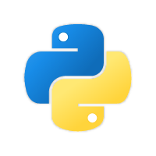

Compute Server
CAS Server (CAS)
SAS Studio
SAS
Python
API
swat
Import pandas
Import requests
Import swat
Notes:
Instead, you can use your favorite Python IDE to achieve similar results. Here, I'll use Visual Studio code on my machine.
To connect to the CAS server from my client, I'll import the SAS scripting wrapper for analytics transfer, or the swat package for short. Once the connection to CAS is made from my client, I can easily upload a DataFrame to the CAS server.
You can also use the saspy package to use Python to work directly with the SAS compute server instead. I will not show that here, but there are some resources below the video.

Slide 11
Using Python in SAS Studio Benefits and Considerations
Benefits
Coding in whichever works best for your situation
Use SAS/ACCESS libraries in the compute server that can access different organization data sources
Using various Python packages to process data
Pulling code from a Python/SAS programmer
Python is managed by your administrator
Using SAS Studio Snippets
Use SAS Studio point and click flows
Schedule python scripts as jobs
Execute background submit
Add visualizations to SAS Visual Analytics from Python scripts

Slide 12
Not meant to replace traditional Python IDEs
Setup from your admin is required
Packages managed by the admin
Considerations

Slide 13
Calls the specified SAS or PROC FCMP functions
SAS.sasfnc("function-name"<, argument-1<, argument-2...>>)
Submits string of SAS code
Compute Server
SAS.submit("SAS code")
Next slide
Pandas DataFrame to a SAS data set
SAS.df2sd(data-frame, 'SAS-data-set',<additional>)
SAS data set to a Pandas DataFrame
SAS.sd2df('SAS-data-set')
Notes:
TAG_MovieNum: Callback Methods That Interact with SAS
When you use the Python editor in SAS Studio, or the PYTHON procedure itself, it provides a module called SAS that enables you to communicate between your SAS session and the PYTHON subprocess. You can submit SAS code or interact with SAS variables within a Python code block by using the following callback methods. Because Python is a case-sensitive language, specify callback methods using the capitalization as it is shown in this list.
<ADVANCE> The SAS.sasfnc method calls the specified SAS or PROC FCMP functions. If the function requires arguments, specify those in a comma-delimited list after the function name.
<ADVANCE> The SAS.submit method submits and executes the specified string of SAS code when the callback method is issued.

Slide 14
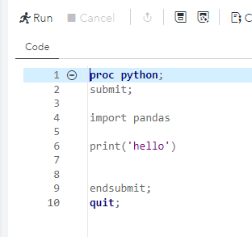
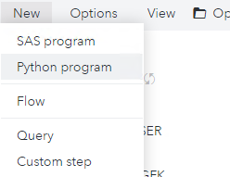
Execute Python Code in SAS Studio
SAS Studio
PROC PYTHON
Python Editor
SAS Viya 2021.1. 3??
SAS Viya 2021.1. 5??
Notes:
TAG_MovieNum: SAS Studio Python Editor
TAG_Audio: Starting in SAS Viya 2021.1.5 SAS Studio now includes a Python editor. You can now integrate Python and SAS in a single environment!
So how does the Python editor work?

Slide 15
SAS® Viya ®
Compute Server
Python Executable
SAS Studio
A standard SAS Viya installation does not have Python support enabled
CAS API
CAS Server (CAS)
Notes:
TAG_MovieNum: evstu1c01_2_c – How Does SAS Studio Work?
TAG_Audio:
Remember, the two primary servers in SAS Viya are the SAS Compute Server and SAS Cloud Analytic Services, or CAS for short. With SAS Studio you have access to both servers to process your data.
<ADVANCE> The SAS Compute Server is the default server that executes your code. If you’re an experienced SAS programmer, <ADVANCE> your SAS programs with traditional SAS®9 code can be executed as is on the Compute Server. When using SAS Studio you can think of the compute server as the client, like the windows client when using JupyterLab.
<ADVANCE> With SAS Studio you can access the CAS server as well. Remember, CAS is the high-performance server available in Viya. <ADVANCE> It performs parallel processing on in-memory data to boost performance and accelerate processing. <ADVANCE> If your code is CAS-enabled, then the Compute Server can push the execution to CAS. SAS Studio provides a specific subset of Viya tasks that generate CAS-enabled code so that you can easily take advantage of the power of CAS. For select steps and SAS programs, it’s likely that you’ll need to make only very minor changes to run them on CAS. You use the CAS server with SAS Studio like you used the CAS server with Python.

Slide 16
default server
executes traditional SAS®9 code
considered the SAS client
Compute Server
SAS Studio
high-performance server
performs parallel processing on in-memory data
executes CAS-enabled SAS code
CAS Server (CAS)

Slide 17
Compute Server
SAS Studio
CAS Server (CAS)

Slide 18
subprocess
Compute Server
SAS Studio
CAS Server (CAS)

Slide 19
Compute Server
CAS Server (CAS)
SAS Studio
SAS
Python
API
Notes:
Let's hop in and let me show you.

Slide 20
subprocess
Compute Server
SAS Studio
Swat package
CAS Server (CAS)

Slide 21





Compute Server
CAS Server (CAS)
SAS Studio
subprocess
Something like:
Access to organizational data that the compute server has or the CAS server has

Slide 22
Execute Python Code in SAS Studio
SAS Studio
Python
Notes:
TAG_MovieNum: SAS Studio Python Editor
TAG_Audio: Starting in SAS Viya 2021.1.5 SAS Studio now includes a Python editor. You can now integrate Python and SAS in a single environment!
So how does the Python editor work?

Slide 23
Execute Python Code in SAS Studio
SAS Viya 2021.1. 3
SAS Viya 2021.1. 5
SAS Studio
PROC PYTHON
Python Editor
Notes:
Let's get into what you came here for. How can you execute Python code in SAS Studio? How does it work?
Well, starting in SAS Viya 2021.1.3 you can use PROC PYTHON to execute python code.
Starting in SAS Viya 2021.1.5 SAS Studio now includes a Python editor.

Slide 24
Execute Python Code in SAS Studio
SAS Viya 2021.1. 3
SAS Viya 2021.1. 5
SAS Studio
PROC PYTHON
Python Editor
Import pandas
Import requests
Import swat
Notes:
The Python editor in SAS Studio is not here to replace your favorite Python editor. The Python editor in SAS Studio simply allows you to easily execute Python scripts your SAS Viya environment. Now there are ways to use your favorite Python editor to work with data in SAS Viya, so watch the end of the video for some surprise content!

Slide 25
Compute Server
CAS Server (CAS)
SAS Studio
subprocess
Admin
Notes:
So how does the Python editor work?
Well, remember SAS Studio is accessed via your browser, and connects to the SAS compute server in SAS Viya.
Now, when you execute the PYTHON PROCEDURE or a .py file in the SAS Studio Python editor, the Python code is sent to the compute server, and the compute server opens a Python subprocess. With the subprocess, the compute server and the Python process can interact with each other.
This Python subprocess allows you to access all organizational data that the compute server or the CAS server has available in SAS Viya.
One thing to be aware of is that the standard SAS Viya installation does not have Python support enabled by default, as the environment runs in a lockdown mode for security purposes. Your Kubernetes and/or SAS Administrator can enable and manage Python for the SAS environment. I have some resources below the video you can check out for more detailed information on this entire process.

Slide 26
Callback Methods
Compute Server
SAS.df2sd()
SAS.sd2df()
SAS.symget()
SAS data set to a Pandas DataFrame
SAS.sd2df('SAS-data-set')
Notes:
TAG_MovieNum: Callback Methods That Interact with SAS
When you use the Python editor in SAS Studio, or the PYTHON procedure itself, it provides a module called SAS that enables you to communicate between your SAS session and the PYTHON subprocess. You can submit SAS code or interact with SAS variables within a Python code block by using the following callback methods. Because Python is a case-sensitive language, specify callback methods using the capitalization as it is shown in this list.
<ADVANCE> The SAS.sasfnc method calls the specified SAS or PROC FCMP functions. If the function requires arguments, specify those in a comma-delimited list after the function name.
<ADVANCE> The SAS.submit method submits and executes the specified string of SAS code when the callback method is issued.

